Slide 1
Compilers 101
Backends - Part 2

Slide 2
Previously…
Preprocessing
Lexical analysis
Frontend
Syntax analysis
Semantic analysis
IR Generation
IR Optimization
Middle-end
Optimization
Backend
Code generation

Slide 3
Previously and this time
Before
Backends structure in general
Today
LLVM backend
Instruction selection (technique overview and comparison)
Backend-specific IRs
Register allocation & instruction scheduling

Slide 4
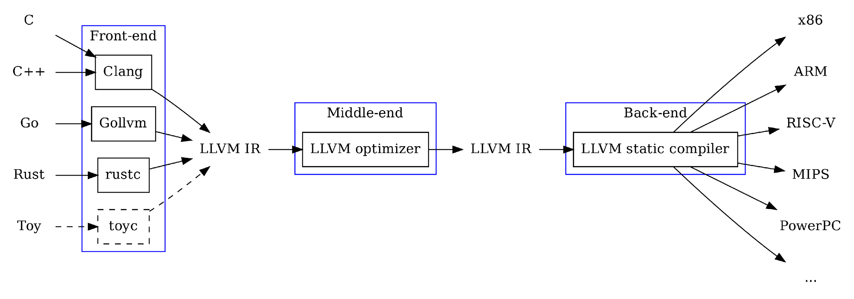
Backend in LLVM

Slide 5
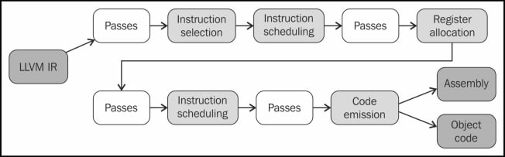
Backend pipeline (overview)

Slide 6
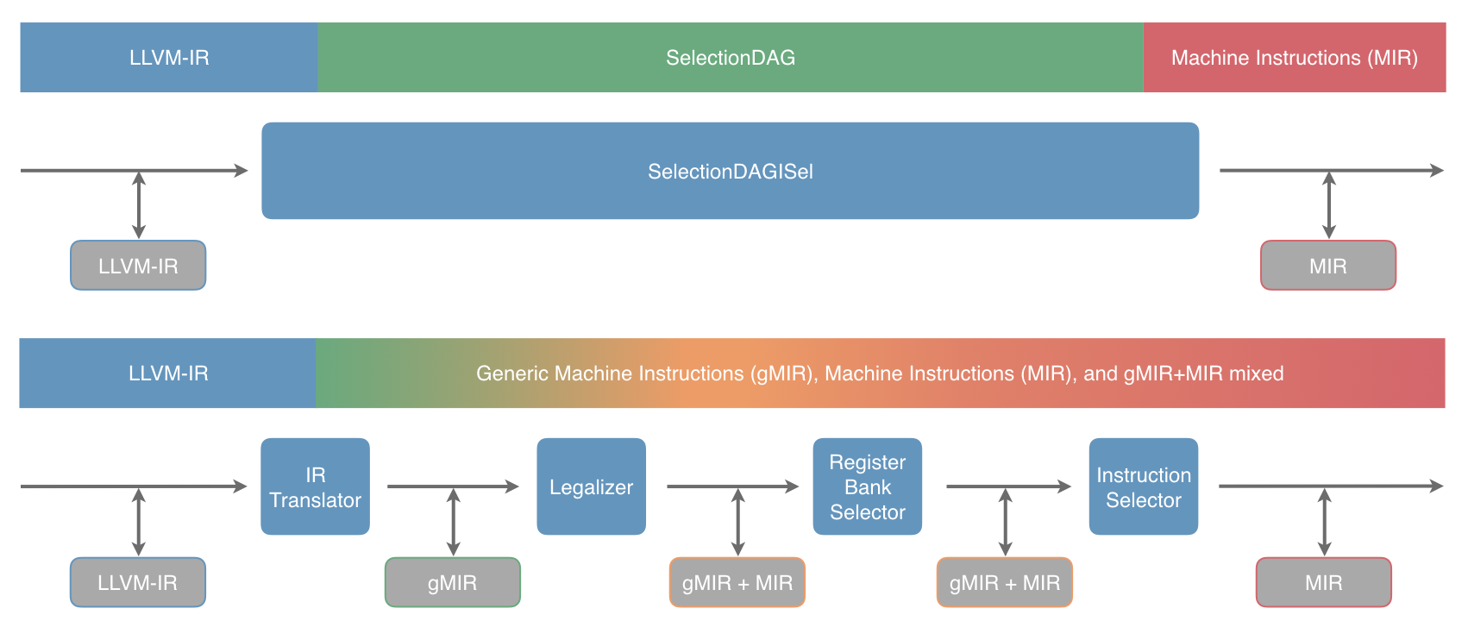
LLVM backend: before and after

Slide 7
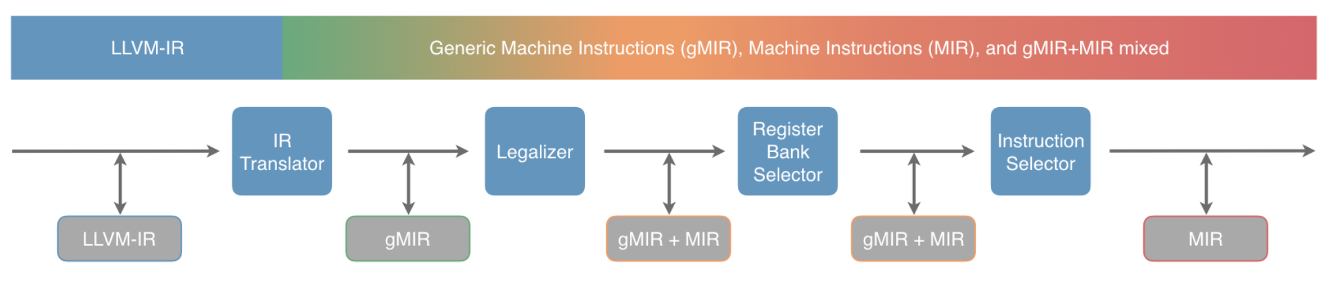
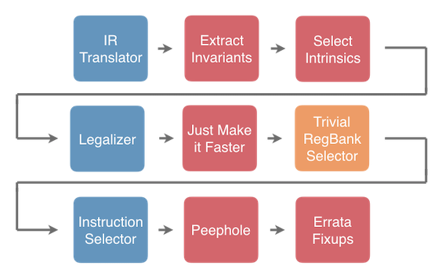
LLVM backend stages

Slide 8
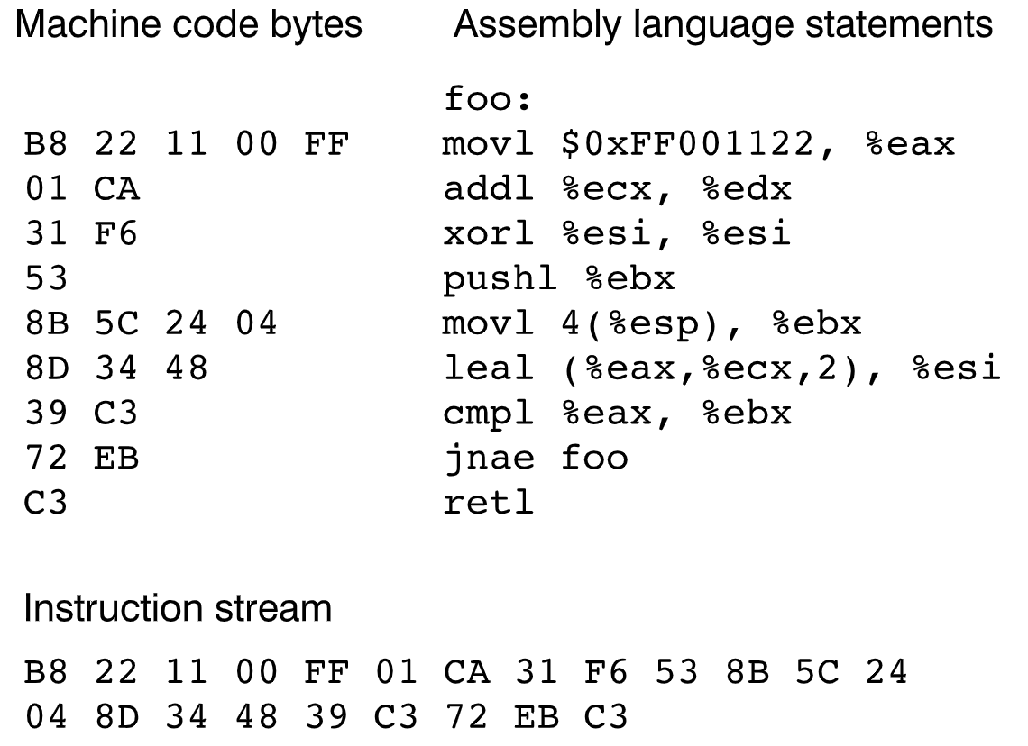
Assembly/machine code

Slide 9
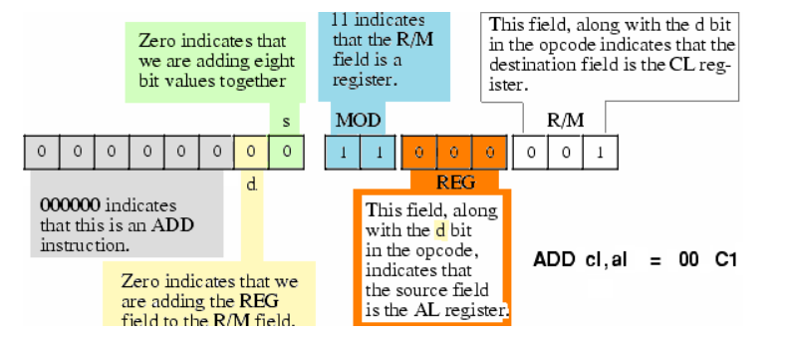
Machine instruction format
http://www.c-jump.com/CIS77/CPU/x86/lecture.html

Slide 10
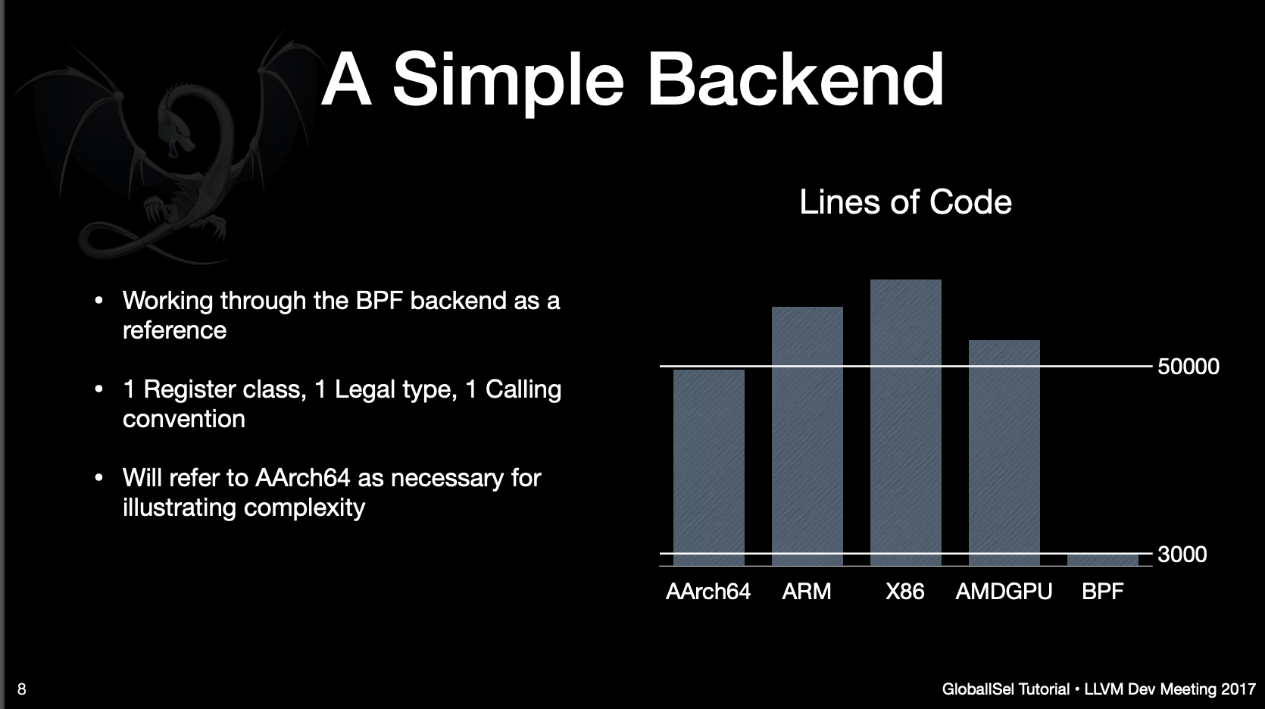
https://llvm.org/devmtg/2017-10/slides/Bogner-Nandakumar-Sanders-Head%20First%20into%20GlobalISel.pdf

Slide 11
Target HW description
Bits of ISA to describe:
Target machine
Registers, register classes
Subregisters (partial registers)
Calling conventions
Subtarget information
Optional features (SIMD instructions, crypto instructions, etc.)
Instruction set
Operands and patterns
Assembly printing and encoding into a machine code
Scheduling parameters
…

Slide 12
TableGen
• A Domain-Specific Language (DSL) originated from the LLVM project.
• Originally invented to describe the instruction table of a LLVM target.
• Ex. The operands, assembly syntax, and ISel rules for each instruction.
• Now: Used in a wide variety of (completely) different areas inside LLVM.
• Instruction scheduling info.
• Declaring IR attributes.
• LLVM Option subsystem (e.g. Clang’s compiler flags).

Slide 13
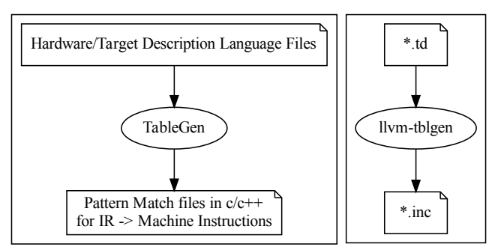
TableGen flow

Slide 14
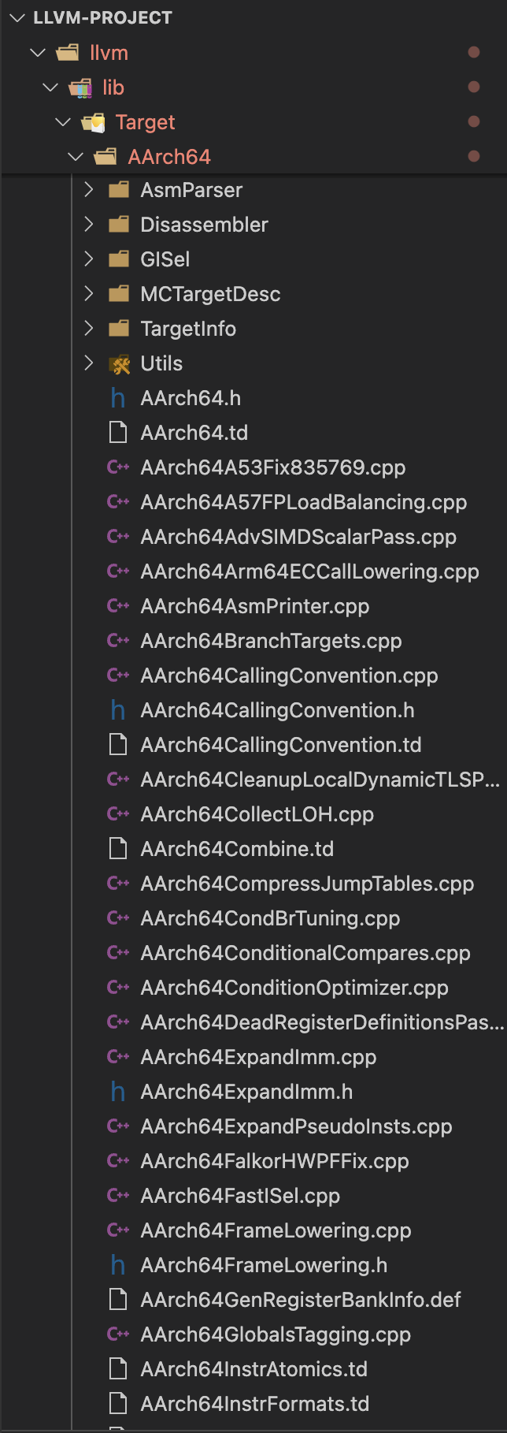
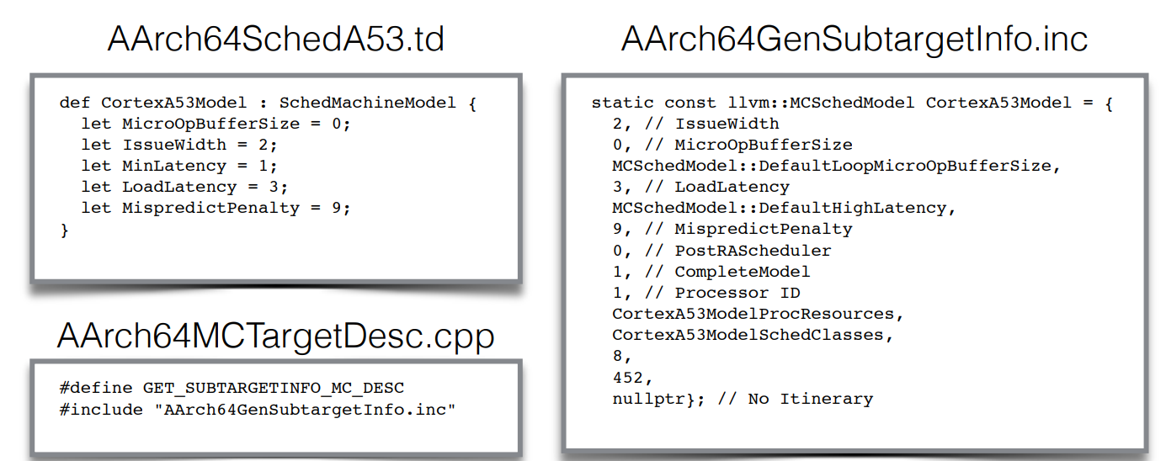
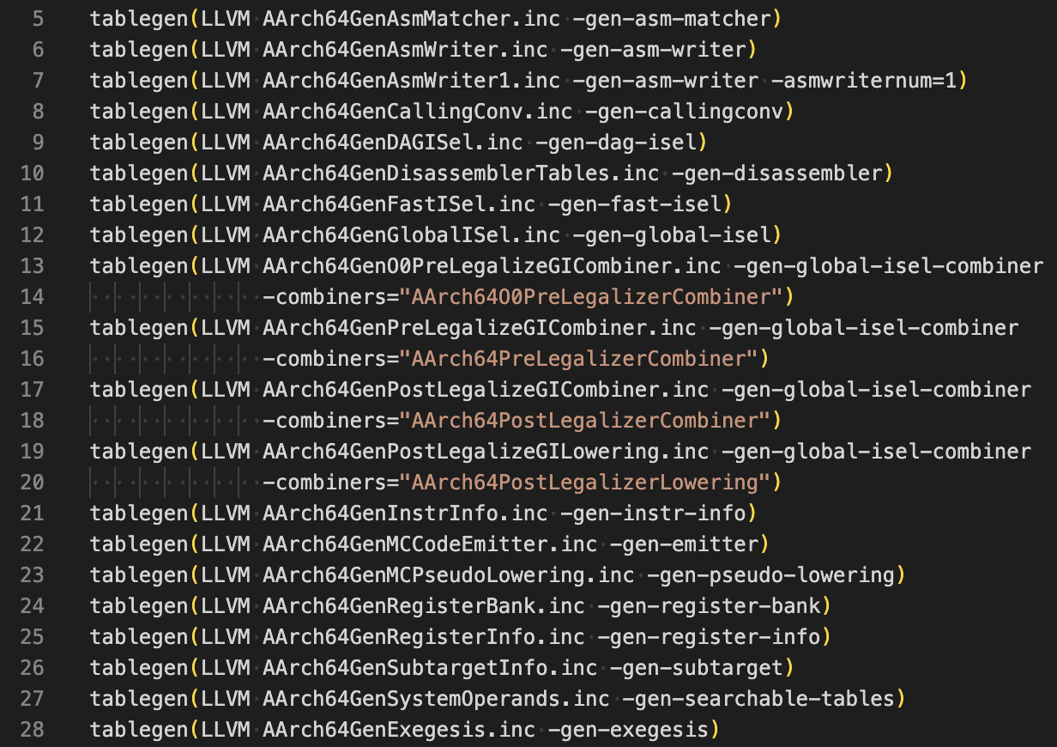
TableGen usage in the source code
CMake
*.td -> *.inc
TableGen td file: AArch64InstrInfo.td
Usage in cpp: AArch64InstrInfo.cpp

Slide 15
Main CodeGen components
Abstract target description
llvm/include/llvm/Target/*
Classes used to represent the code being generated for any target
llvm/include/llvm/CodeGen/*
Classes and algorithms used to represent code at the object file level, MC layer
llvm/include/llvm/MC/*, llvm/lib/llvm/MC/*
Target-independent algorithms used to implement various phases of native code generation (reg allocation, scheduling, stack frame representation, etc)
llvm/lib/CodeGen/*
Implementation of abstract target description interfaces for particular targets
llvm/lib/Target/<TargetName>/*
Generated tablegen files for a target
<llvm build dir>/llvm/lib/Target/<TargetName>/*

Slide 16
Target description classes
TargetMachine class – API for accessing target-specific instances of various target description classes
DataLayout class – target layout (how data types, structs, pointers lays out in memory) specification API
TargetLowering class – Instruction selection DAG/ISel lowering information
TargetRegisterInfo class – describes the register file and any interactions between registers
TargetInstrInfo class – describes machine instructions
TargetFrameLowering class – provides information about stack frame layout
TargetSubtarget class – provides information about specific chipset of a target chip architecture
…

Slide 17
Backend code IR transformations
Instruction selection
Scheduling and formation
SSA-based machine code optimizations
Registers allocation
Prolog/epilog code insertion
Late Machine code optimizations
Code emission
LLVM IR
SelectionDAG/MachineDAG/gMIR/MIR
MachineFunction/MachineBasicBlock/MachineInstr
MCSymbol/MCSection/MCInst/…

Slide 18
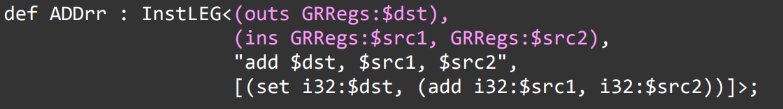
Instruction description in tablegen
List of definitions or outputs ('outs')
List of uses or inputs ('ins')
Operand class:
– Register class (e.g. GRRegs)
– Immediate (e.g. i32imm)
– More complex operands (e.g. reg + imm for load/store)

Slide 19
Instruction selection
LLVM provides several instruction selection frameworks
SelectionDAG
FastISel
GlobalISel

Slide 20
SelectionDAG pipeline
DAG Build phase
Optimization
Legalize types
Legalize operations
Select instructions
Scheduling and formation

Slide 21
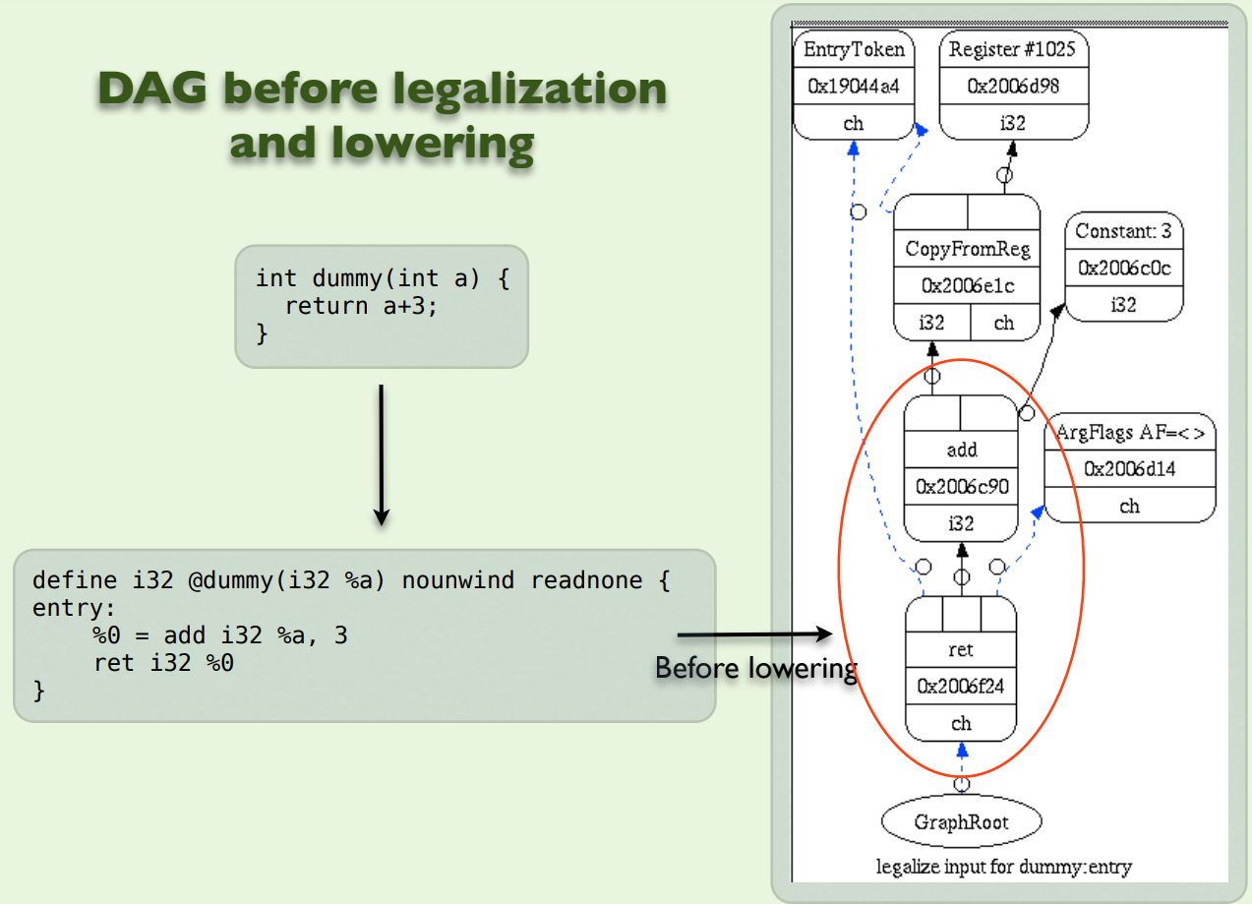
SelectionDAG

Slide 22
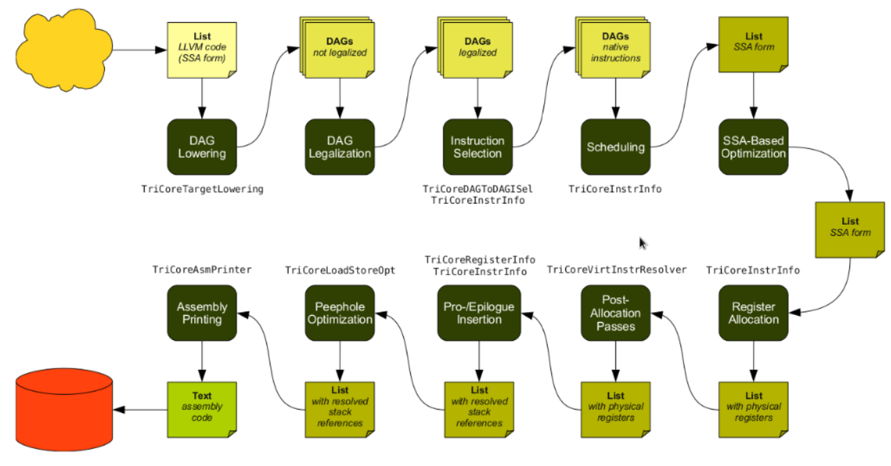
SelectionDAG: Legacy LLVM backend pipeline

Slide 23
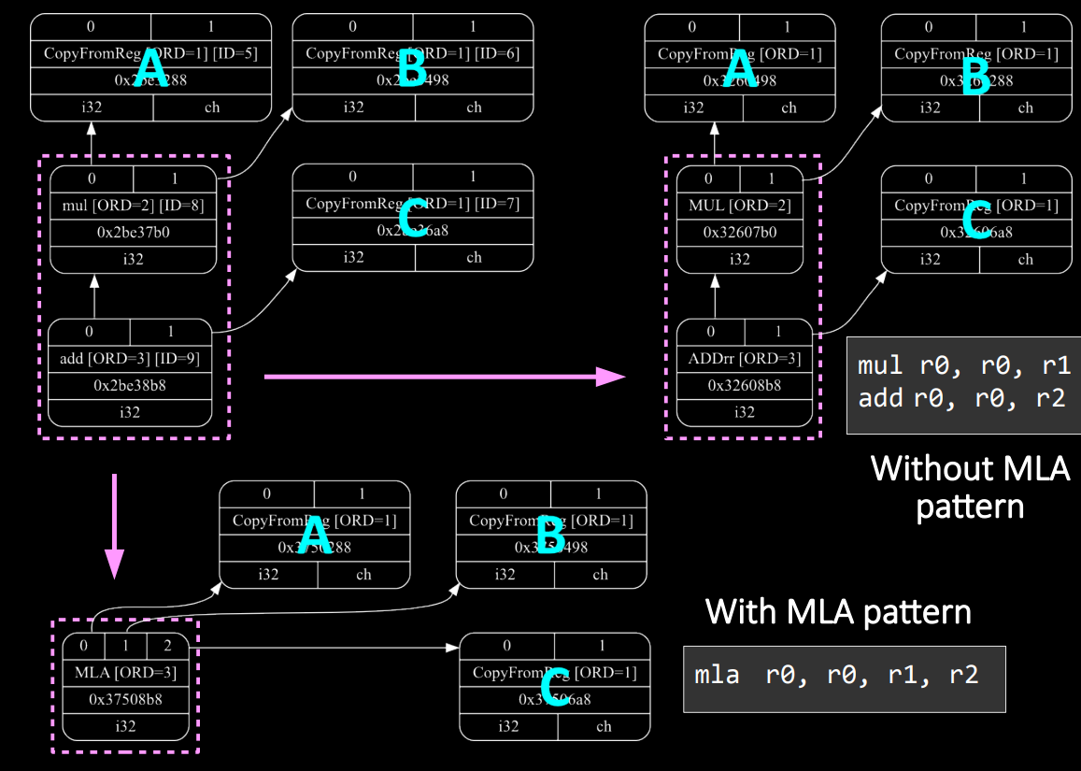
SelectionDAG: Matching multiple Dag nodes

Slide 24
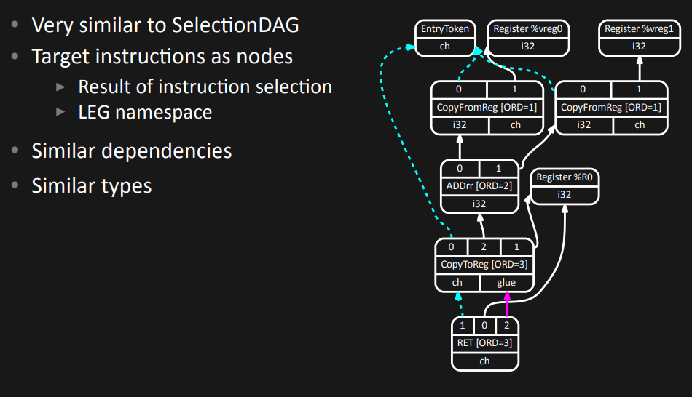
SelectionDAG: MachineDAG after legalization and lowering

Slide 25
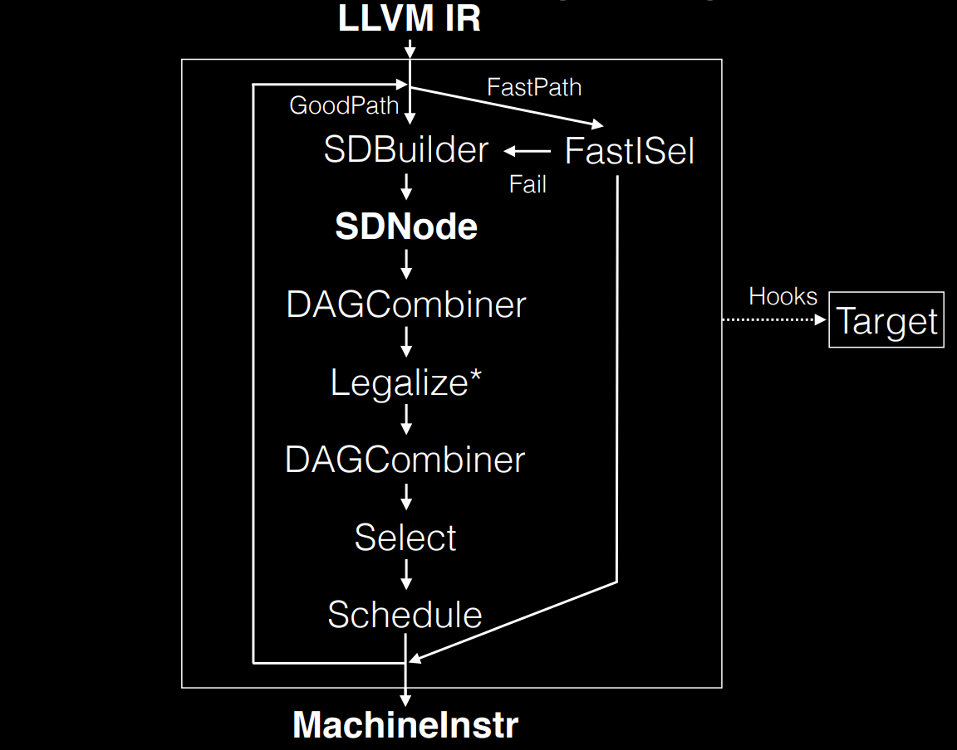
FastISel: selection path
Tries to generate code as fast as possible
Runs at -O0
Shares a little amount of code with SelectionDAG
Falls back to SelectionDAG if something goes wrong

Slide 26
GlobalISel
The modern way of instruction selection

Slide 27
Major problems that GlobalISel solves
Performance – SelectionDAG introduces yet another intermediate representation, which has compile-time cost. GlobalISel directly operates on MIR.
Granularity – GlobalISel operates on the whole function, but SelectionDAG and FastISel operate on individual basic blocks.
Modularity - SelectionDAG and FastISel are radically different and share very little code. GlobalISel is built in a way that enables code reuse.

Slide 28
Fallback to SelectionDAG
If GlobalISel cannot handle some input IR, it falls back to SelectionDAG for that specific function.
Since fallback mechanism exists, some backends may have partial support for GlobalISel
Eventual goal for backends that support GlobalISel is to have no fallback at all
Brand-new backends do not use SelectionDAG at all, so they don’t have this fallback

Slide 29
What backends support GlobalISel
AArch64, 2017-…
Has GlobalISel implementation to some extend (-global-isel compiler flag to force it):
ARM
AMDGPU
SPIRV
RISCV
X86 (falls back to SelectionDAG quite often)

Slide 30
gMIR and MIR
Generic MIR (gMIR) is an intermediate representation that shares the same data structures as MachineIR (MIR) but has more relaxed constraints. As the compilation pipeline proceeds, these constraints are gradually tightened until gMIR has become MIR.
gMIR is being gradually lowered to MIR

Slide 31
MIR
At the high-level, LLVM code is translated to a machine specific representation formed out of MachineFunction, MachineBasicBlock, and MachineInstr instances (defined in include/llvm/CodeGen). This representation is
completely target agnostic, representing instructions in their most abstract form: an opcode and a series of operands.
designed to support both an SSA representation for machine code, and a register allocated, non-SSA form.
MIR is a human-readable serialization format that is used to represent LLVM’s machine specific intermediate representation.
Language reference: https://llvm.org/docs/MIRLangRef.html

Slide 32
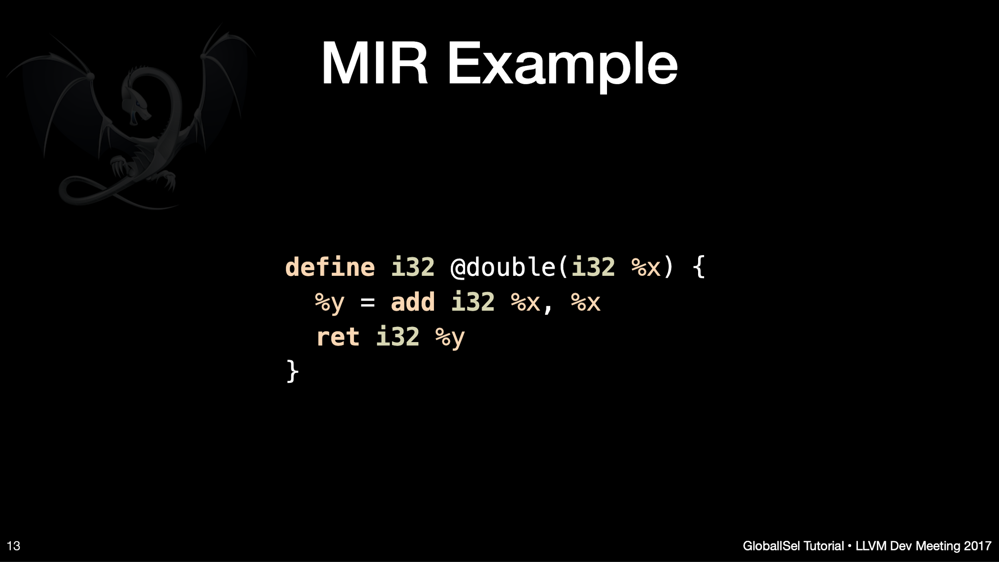
https://llvm.org/devmtg/2017-10/slides/Bogner-Nandakumar-Sanders-Head%20First%20into%20GlobalISel.pdf

Slide 33
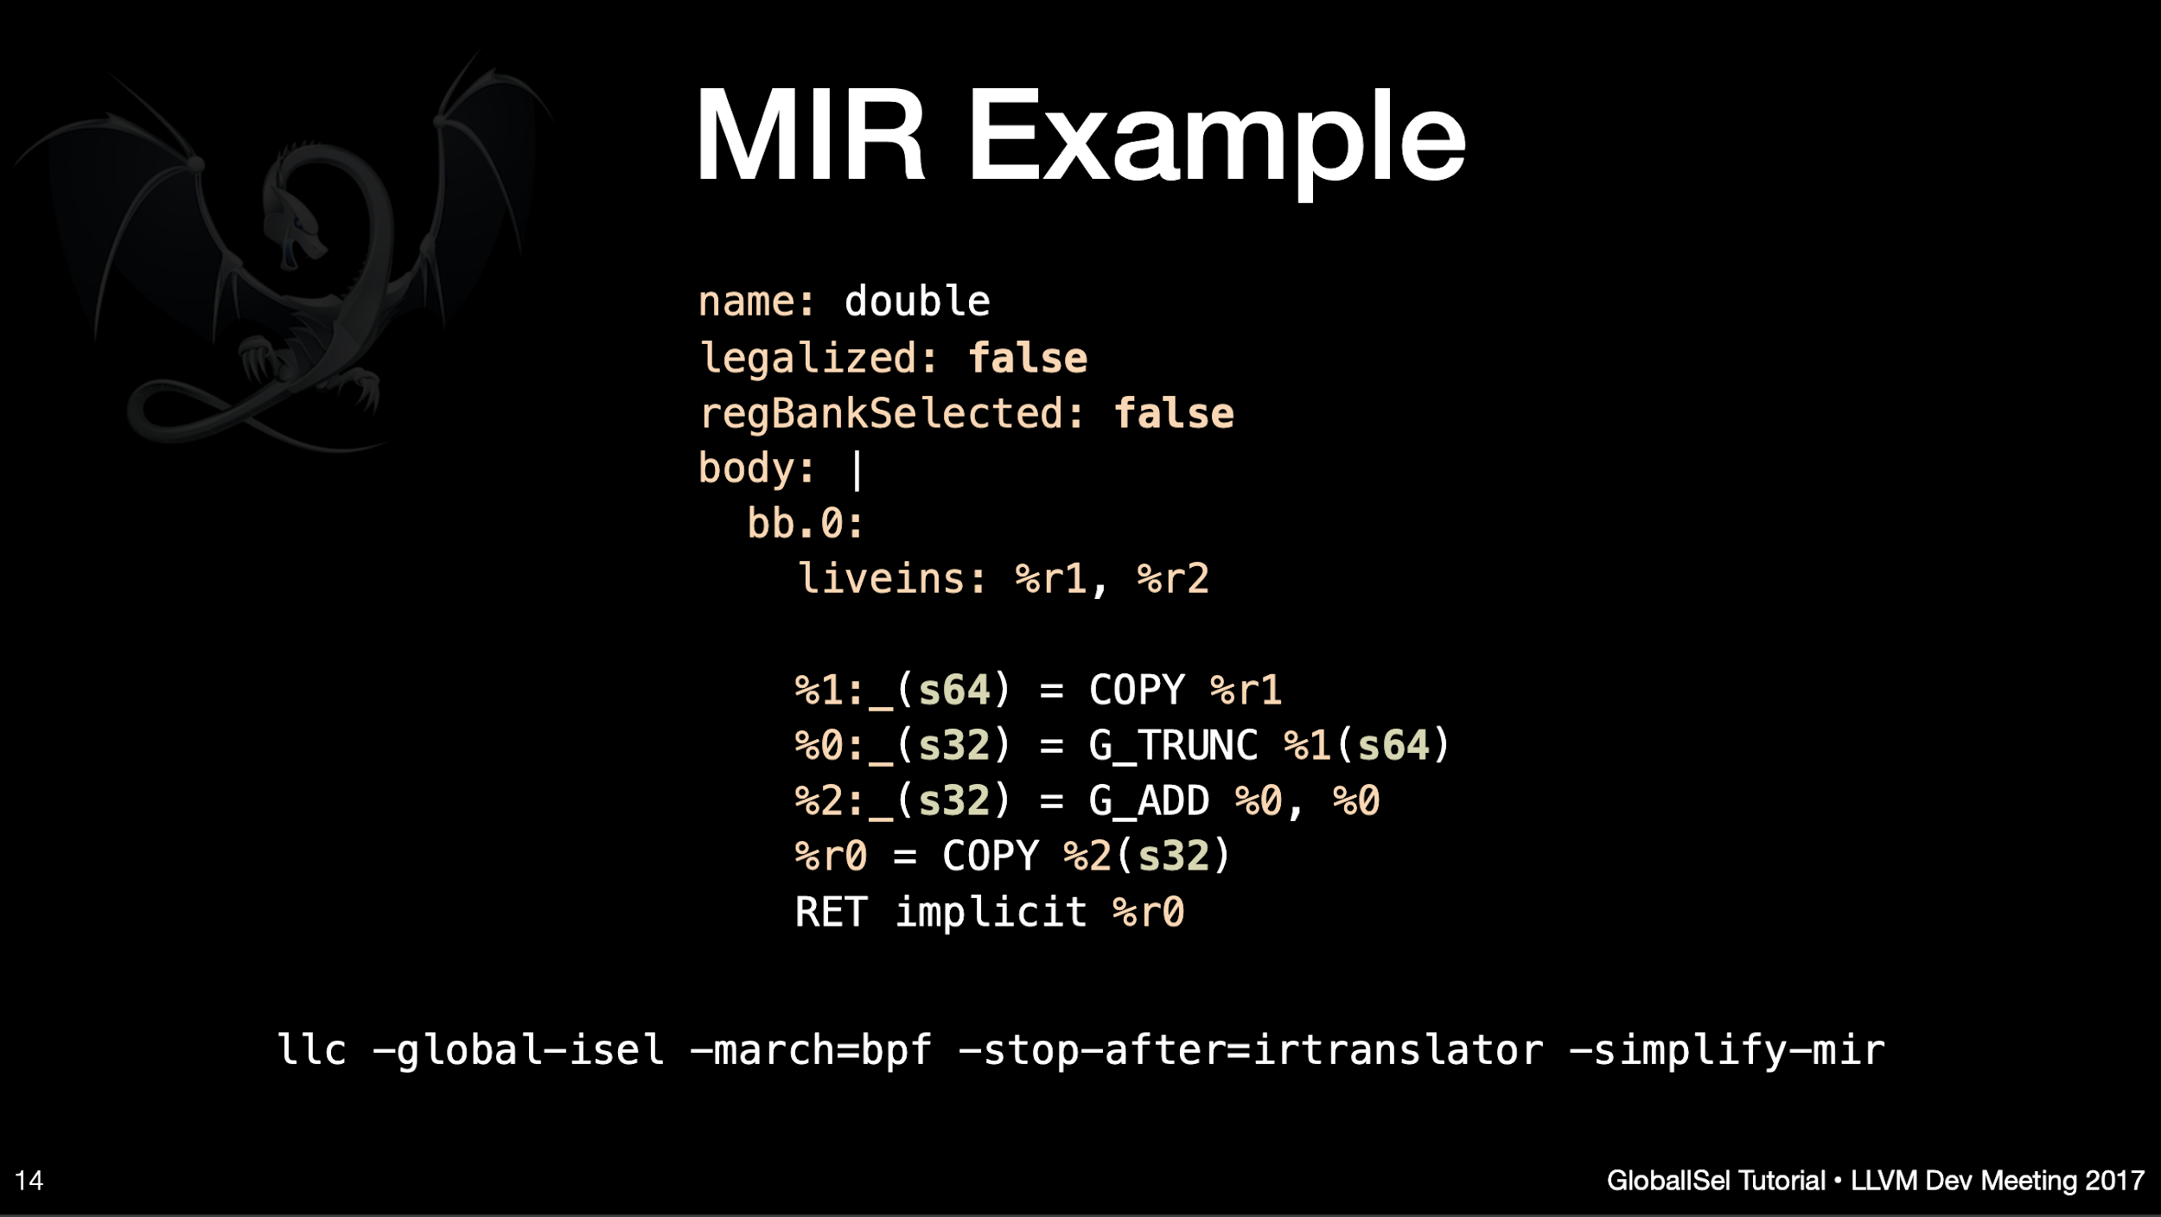
https://llvm.org/devmtg/2017-10/slides/Bogner-Nandakumar-Sanders-Head%20First%20into%20GlobalISel.pdf

Slide 34
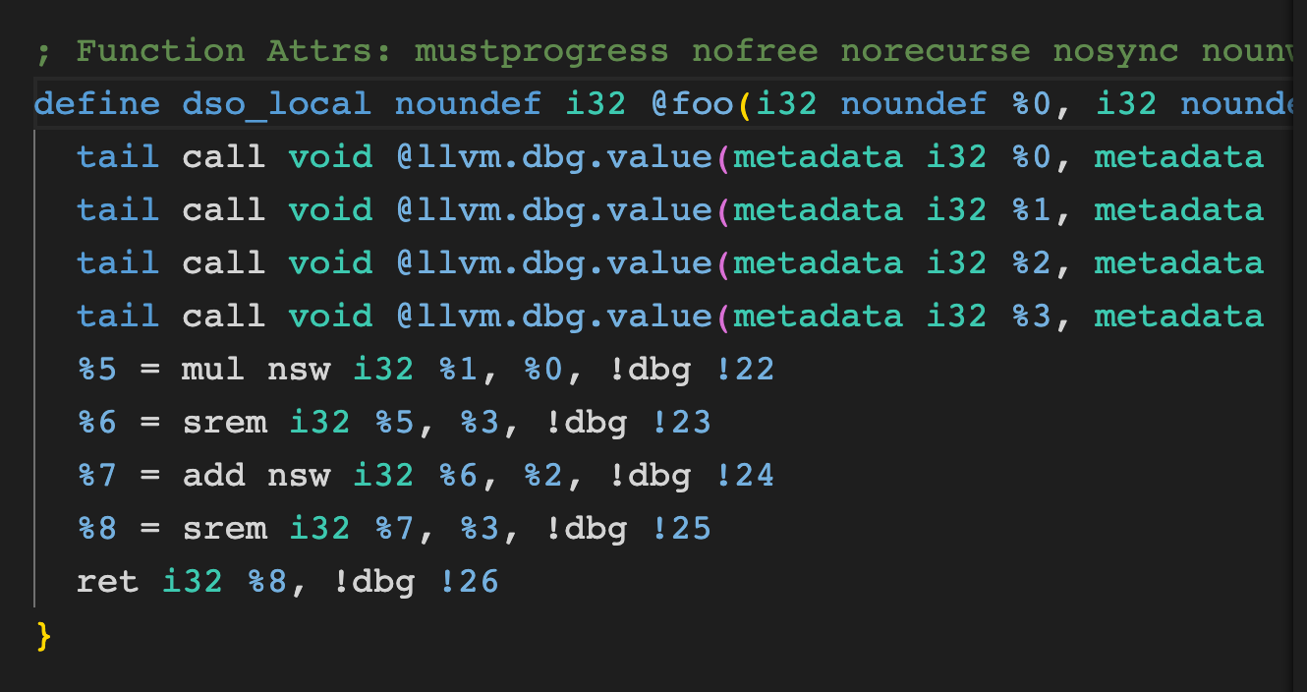
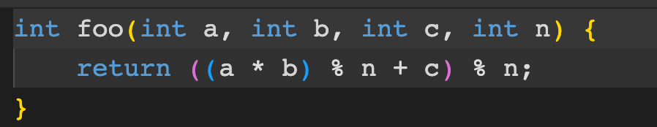
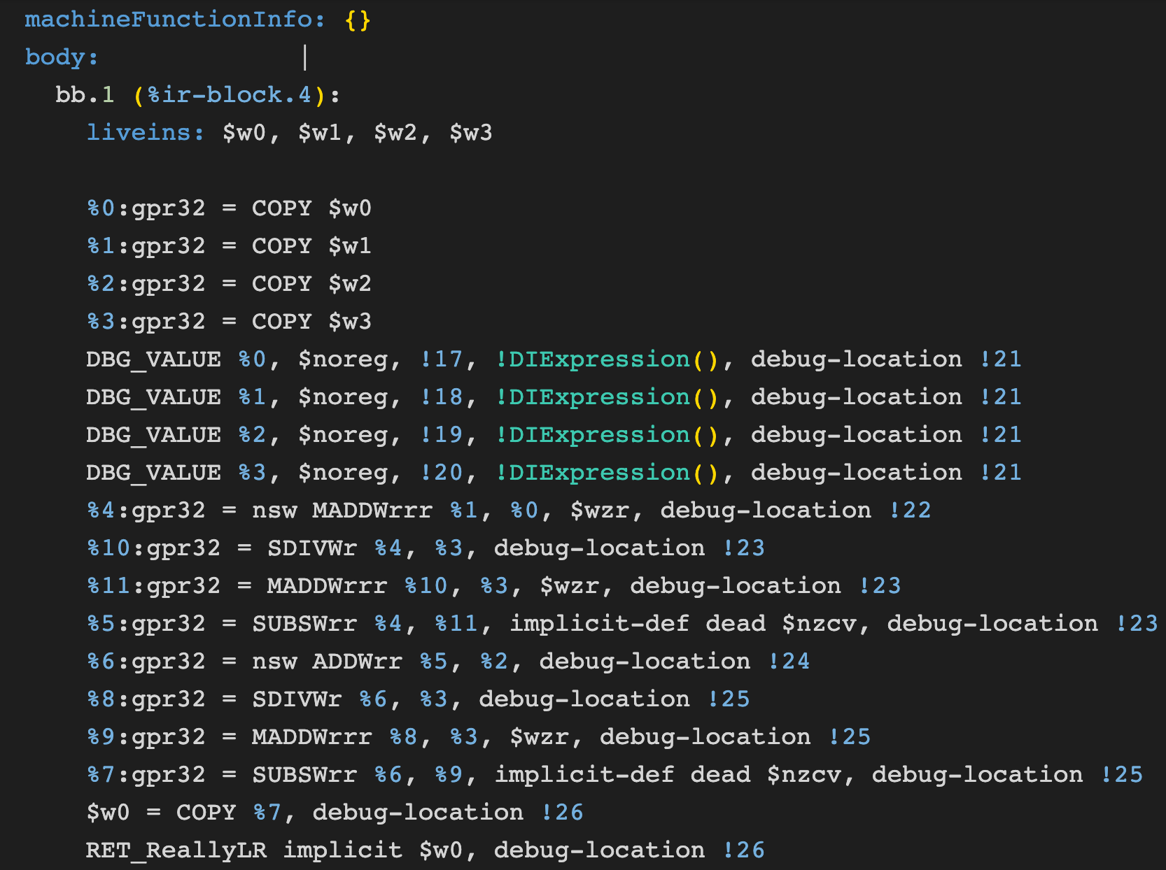
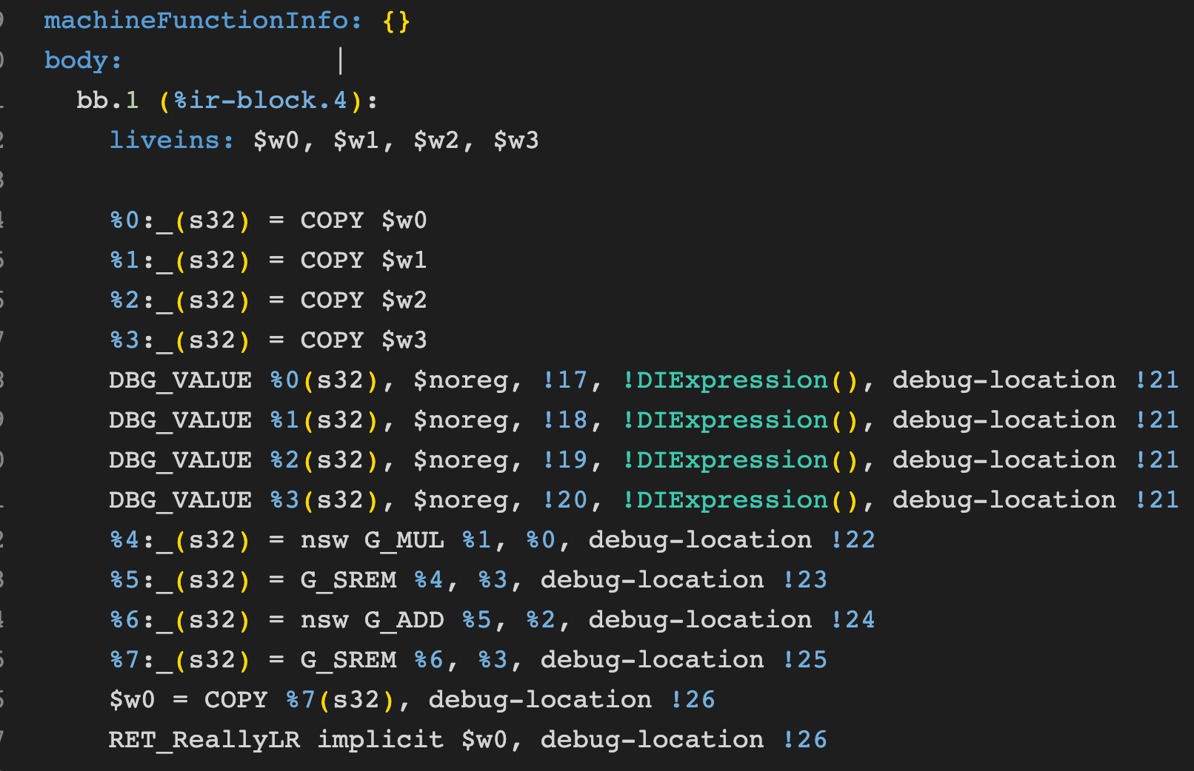
gMIR and MIR showcase
* collected for AArch64 architecture
C++
LLVM IR
MIR
gMIR

Slide 35

gMIR and MIR showcase
C++ -> LLVM IR:
LLVM IR -> gMIR:
LLVM IR -> MIR:
C++ -> AArch64 asm:
https://godbolt.org/z/T65on9G38
https://godbolt.org/z/99T9v46Eo
https://godbolt.org/z/rGo6xc6jK
https://godbolt.org/z/TvdcbfWbK

Slide 36
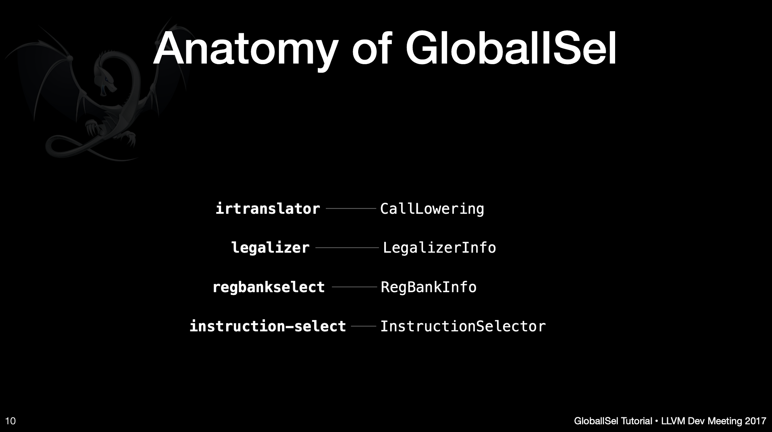
https://llvm.org/devmtg/2017-10/slides/Bogner-Nandakumar-Sanders-Head%20First%20into%20GlobalISel.pdf

Slide 37
Register allocation
1. Linear Scan Register Allocation
Basic Linear Scan: Allocates registers based on the linear order of variables' live ranges. It's a faster and simpler method compared to graph coloring, but may not be as optimal in register usage.
Improved Linear Scan: Enhancements over the basic linear scan to better handle specific cases, like variables with multiple live ranges, through splitting and spilling techniques.
2. Graph Coloring
Chaitin-Briggs Graph Coloring: An algorithm that models register allocation as a graph coloring problem, where each variable is a node, and an edge between two nodes indicates that the variables interfere (cannot be assigned the same register). The aim is to color the graph with the minimum number of colors (registers), where no two adjacent nodes share the same color.
Iterated Register Coalescing: An advanced version that combines graph coloring with coalescing, a process of merging nodes (variables) to reduce the need for move instructions, optimizing further for performance.
3. PBQP (Partitioned Boolean Quadratic Programming)
A more sophisticated approach that can model complex register allocation problems including those with irregular architectures and special register requirements. It uses a mathematical framework to find the optimal solution, balancing between computational complexity and allocation quality.
4. Fast Register Allocation
A heuristic-based approach designed for speed, suitable for just-in-time (JIT) compilation scenarios where compilation time is critical. It may not always produce the most optimal register usage, but is significantly faster than more complex algorithms

Slide 38
Scheduling
LLVM uses Machine Instruction Scheduler (MIScheduler)
List Scheduler suitable for VLIW, out-of-order, and in-order machines
Schemes: Top-Down, Bottom-Up, or Bi-Directional
Heuristics:
Register Pressure
Register pressure measures the availability of free registers at any point in time during the program execution. The higher the register pressure, the more often the register contents must be spilled into memory. Increasing the number of registers in an architecture decreases register pressure but increases the cost.
Latency
others

Slide 39
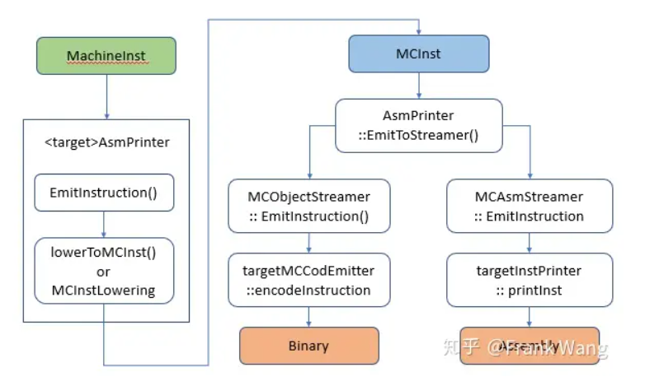
Code emission

Slide 40
Lab assignment #3
Write a pass in LLVM BackEnd
Deadline: May, 7
Where to seek help
https://llvm.org/docs/WritingAnLLVMBackend.html
https://github.com/llvm/llvm-project/tree/main/llvm/lib/Target/X86/X86AvoidTrailingCall.cpp
Contact teachers

Slide 41
Next time…
MLIR

Slide 42
Extra materials
Head First into GlobalISel (Or: How to delete SelectionDAG in 100* easy commits): https://llvm.org/devmtg/2017-10/slides/Bogner-Nandakumar-Sanders-Head%20First%20into%20GlobalISel.pdf
LLVM Developers’ Meeting: J. Bogner & A. Nandakumar & D. Sanders “Tutorial: GlobalISel ” - https://www.youtube.com/watch?v=Zh4R40ZyJ2k
Tutorial: Creating an LLVM Backend for the Cpu0 Architecture - https://jonathan2251.github.io/lbd/
https://llvm.org/devmtg/2014-04/PDFs/Talks/Building%20an%20LLVM%20backend.pdf
GlobalISel vs SelectionDAG:
2017 LLVM Developers’ Meeting: “GlobalISel: Past, Present, and Future“: https://www.youtube.com/watch?v=McByO0QgqCY
2019 LLVM Developers’ Meeting: V. Keles & D. Sanders “Generating Optimized Code with GlobalISel”: https://www.youtube.com/watch?v=8427bl_7k1g
2021 LLVM Dev Mtg “Bringing up GlobalISel for optimized AArch64 codegen”: https://www.youtube.com/watch?v=S6SNs2ttdoA
2023 EuroLLVM - Tutorial: GlobalISel by example: https://www.youtube.com/watch?v=PEP0DfAT_N8
Instruction scheduling:
SchedMachineModel: Adding and Optimizing a Subtarget: https://llvm.org/devmtg/2014-10/Slides/Estes-MISchedulerTutorial.pdf
Scheduler for in-order processors. What’s present, and what’s missing in LLVM? https://llvm.org/devmtg/2016-09/slides/Absar-SchedulingInOrder.pdf
Global instruction scheduling: https://llvm.org/devmtg/2014-10/Slides/Larin-GlobalInstructionScheduling.pdf

Slide 43
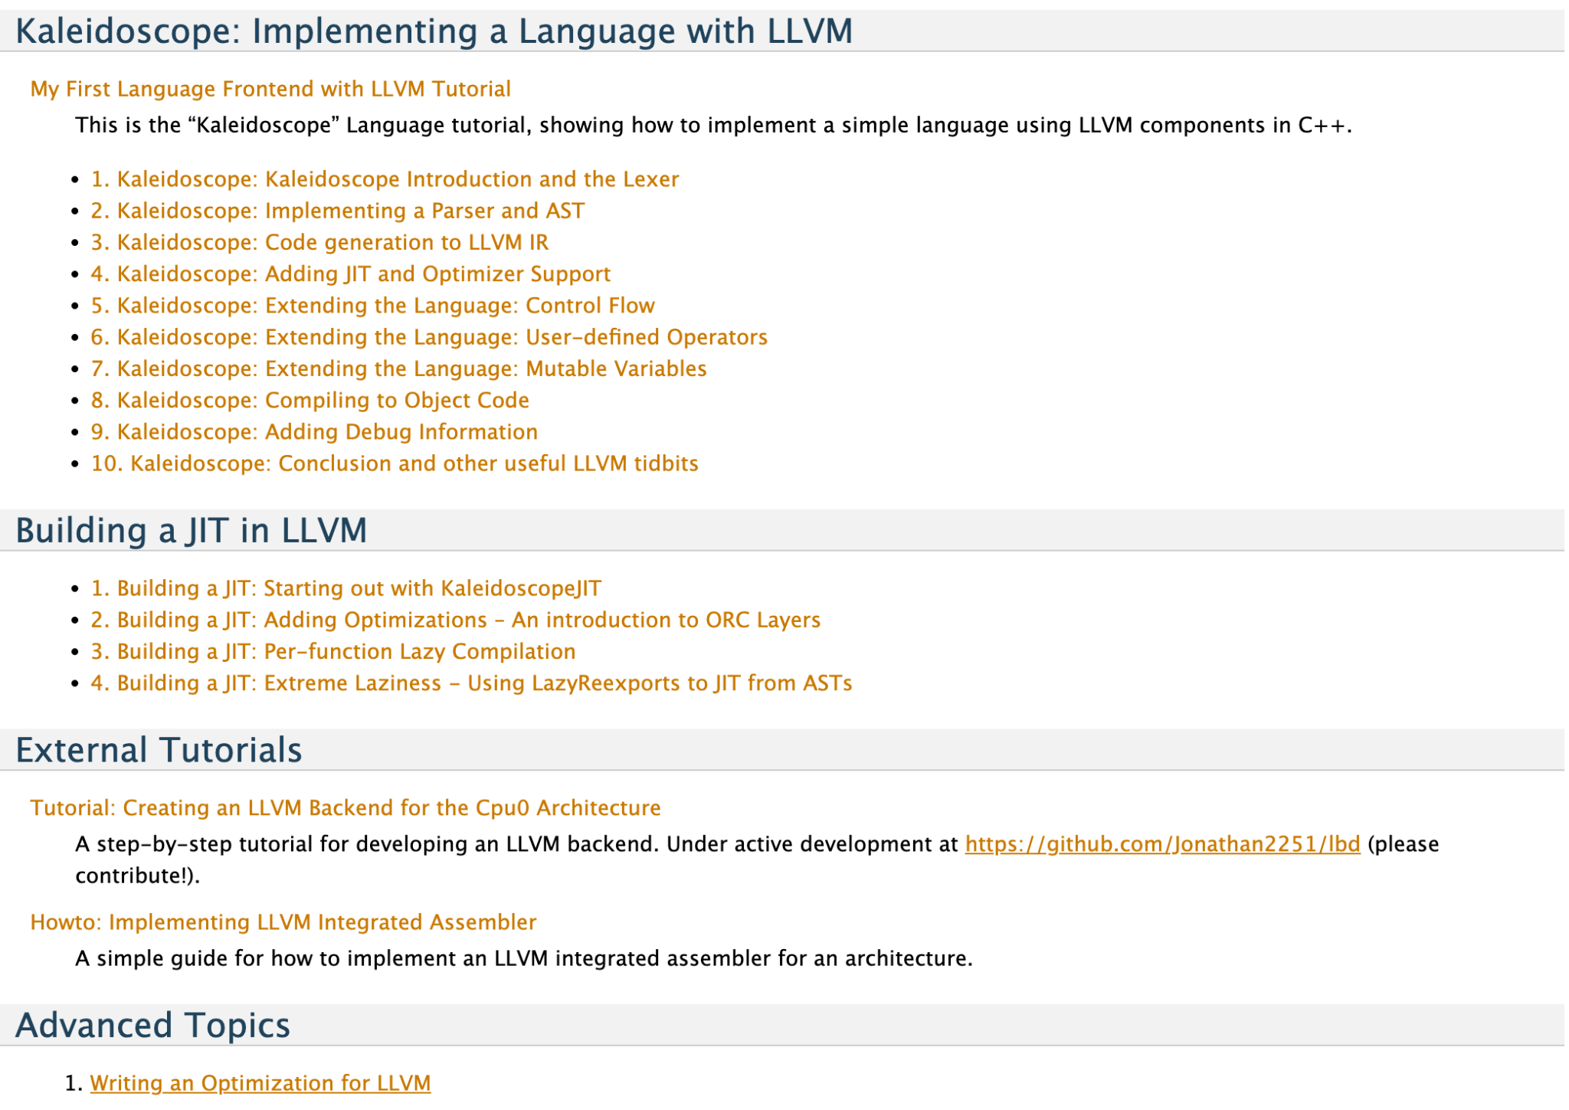
Kaleidoscope
https://llvm.org/docs/tutorial/

Slide 44

Test
https://forms.gle/DNSVyJseXjjAfuZe8
Submission time: 10 minutes
Backup: me@gooddoog.ru

Slide 45


Test
https://forms.gle/6VZg8py1f6ojEcxY7
Submission time: 10 minutes
Backup: me@gooddoog.ru

